Slide 1

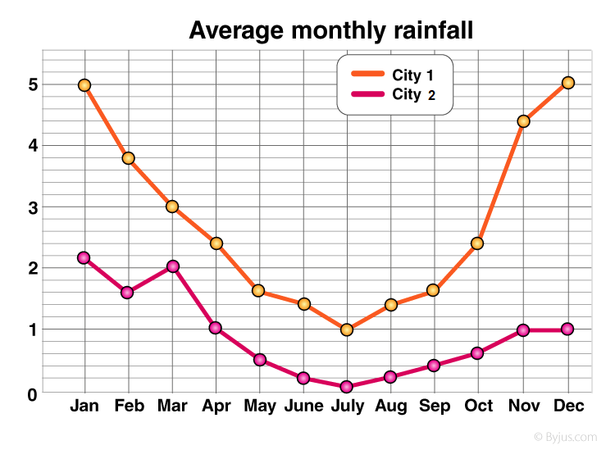
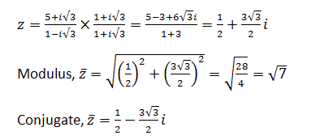
Guidelines for Preparing Your Poster Presentation: Feel Free to Adapt
Author A, Author B, Author C
Author A’s affiliation X
Author B’s affiliation Y
Author C’s affiliation Z
Abstract
  A brief overview of the study's purpose, methods, key findings, and conclusions.
  It should provide a quick understanding of your work for those who may not have time to read the entire poster.
Introduction
Example Figure
  A concise explanation of the research problem or question, its significance, and any relevant background information or context.
  This section sets the stage for understanding the study's objectives.
Conclusions
  Summarize the main outcomes of your study, interpret their significance, and relate them back to the research question or hypothesis.
  Discuss any implications, limitations, future directions, or practical applications of your findings.
  This section should clearly convey the "take-home message" of your research.
Materials and Methods
  Describe the research design, participants (if applicable), data collection methods, instruments, procedures, and statistical analyses used.
  This section should be detailed enough for others to understand and replicate your study, but concise enough to avoid overwhelming the viewer.
References
  List the sources cited in your poster using a recognized citation style (e.g., APA, MLA, Chicago).
  This demonstrates the academic foundation of your work and allows interested viewers to access further information.
Example formula
Acknowledgments
  Recognize any funding sources, collaborators, advisors, or institutions that contributed to your research.
  This is an opportunity to express gratitude and acknowledge support.
Results
  Present your key findings using visual aids such as graphs, tables, diagrams, images, or other relevant illustrations.
  These visuals should be clear, self-explanatory, and appropriately labeled.
  Include only the most important and relevant results that support your conclusions and avoid overwhelming the viewer with excessive data.
Contact Information
  Provide your name, email address, and/or other relevant contact details so that interested viewers can reach out to you for further discussion or follow-up questions.

